Slide 1
Floorplanning with Soft Rectilinear Blocks Using Corner Block List
第五組
電機4B 108501020 顏家祥
電機4B 108501021 張珈瑋
電機4B 108501025 沈冠璋

Slide 2
Outline
PART 1. Introduction
PART 2. CBL Representation
PART 3. Obstacle-Based Method
PART 4. The Floorplanning Algorithm
PART 5. Result and Conclusion

Slide 3
Part 1
Introduction

Slide 4
Abstraction
Proposing a CBL-based algorithm with obstacle-based method and a replace-upon-overlap mechanism to handle arbitrary soft rectilinear blocks.

Slide 5
Why We Need This CBL-based Algorithm
Traditional methods have two drawbacks:
Diminishing violation of the constraints is time consuming.
Can only handle hard rectilinear blocks of fixed shaped.
This CBL-based algorithm’s advantages:
Efficiency: converge quickly in SA
Generality: can handle both hard and soft rectilinear module
Notes:
每一種演算法都有各自的表示規則 要消除掉違反這些規則的情況很耗時間

Slide 6
Part 2
CBL(Corner Block List) Representation

Slide 7
Corner Block Representation
Corner block (CB) is the block at upper-right corner of the floorplan
Block f is the CB of this floorplan
The left and bottom bounding segments of CB forms a T junction
Corner Block
b
f
c
e
d
a

Slide 8
T Junction
b
f
b
e
f
c
e
c
d
d
a
a
Vertical CB
Horizontal CB

Slide 9
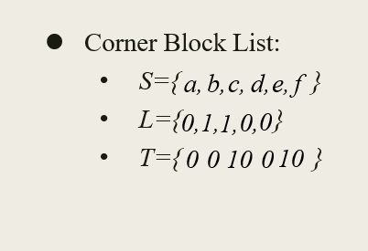
Corner Block List (CBL)
CBL is constructed by recursive deletion of CBs in the floorplan.
In each deletion, it records:
Name List S
Store name of CB
Orientation List L
Store orientation of a CB (vertical=0, horizontal=1)
T Junction List T
Store # of attached T junction (by successive 1’s ended by a 0)

Slide 10
Example for Construct a CBL
Corner Block
Corner Block
Corner Block
b
c
e
b
c
d
b
f
Corner Block List:
S={ }
L={ }
T={ }
d,
e,
f
1,
0,
0
10
10
Vertical CB
0
c
e
1 attached T
Vertical CB
d
d
horizontal CB
a
a
a
0 attached T
1 attached T

Slide 11
Example for Construct a CBL
Corner Block
Corner Block
b
c
b
Corner Block List:
S={ }
L={ }
T={ }
a,
b,
c,
d,
e,
f
0,
1,
1,
0,
0
0
0
10
10
0
Horizontal CB
a
a
horizontal CB
0 attached T
0 attached T

Slide 12
b
f
f
b
b
c
e
c
e
d
a
a
d

Slide 13
Part 3
Obstacle-Based Method

Slide 14
Shielding Region
Shielding Region:
Def: Shielding Region of a packed corner block M is 2D region defined by (0,x(M)) × (0,y(M)), where (x(M),y(M)) is the upper right corner of M.
Lemma 1:
Any successive blocks can’t be packed inside the shielding regions of previous corner blocks.
(x(c),y(c))
c
b
d
a

Slide 15
Obstacle List
Obstacle
b
a1
a2
a1
a2
Can’t be used
b

Slide 16
Replace-upon-Overlap Mechanism
Shield block:
Shield block of an obstacle is a false rectangle block of variable dimensions, whose function is to shield the obstacle from being overlapped by successive blocks
Lemma 2:
After the shield block is packed as a corner block, the corresponding obstacle will never be overlapped by any successive blocks
Notes:
在這個機制中定義了新的區域叫shield BLOCK，用來避免後面放入的module漢obstacle 重疊，因此有了定義2，shield block 的效果和shield region依樣，後面放入的modul不會和shield block重疊，避免overlap

Slide 17
Avoid Overlapping
Shield Block of a1
Overlap
a1
a2
a1
a2
b
After shield block is packed, we need to update the obstacle list by deleting the corresponding entry in it

Slide 18
Multiple Overlap
Criterion of selection
If the CB is vertically oriented, we select the overlapping obstacle with the lowest upper boundary.
If the CB is horizontally oriented, we select the overlapping obstacle with leftmost right boundary.
B2
C
C
B1
B1
A

Slide 19
Part 4
The Floorplaning Algorithm

Slide 20
Shape of Corner Block
a1
Soft rectilinear block a
a2’
a2
a3’
Each rectilinear block is partition into a set of rectangle subblocks.
Each block has one corresponding entry in list S.
For soft rectilinear blocks, the selection of their shape is integrated in move set of SA.
a1’
b
Rectangle block b
c1
c2
Hard rectilinear block c
List S={a, b, c}

Slide 21
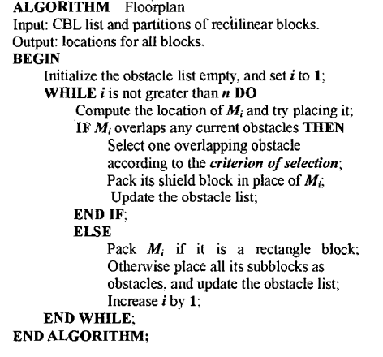
Floorplanning Algorithm
The floorplanning algorithm is embedded in the inner loop of simulated annealing.

Slide 22
Floorplanning Algorithm

Slide 23
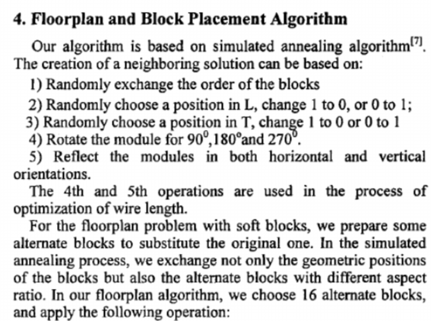
Move in Simulated Annealing
1. Exchange order of the block.
2. Choose a position in L, change 1 to 0, or 0 to 1.
3. Choose a position in T, change 1 to 0, or 0 to 1.
4. Select an alternative shape to substitute the original one rectilinear soft block.

Slide 24
Part 5
Result and Conclusion

Slide 25
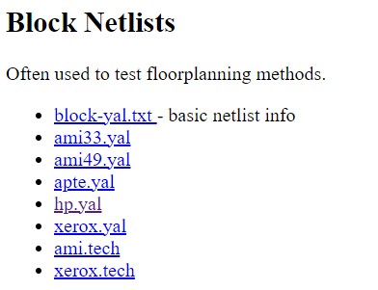
Experimental Design
C language, MCNC benchmark
Objective: Minimize total area
Aspect ratio of rectangle block: 0.5~2
MCNC benchmark

Slide 26
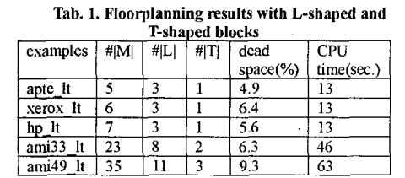
Experimental Result 1
To test efficiency of handling hard rectilinear block, the paper expanded several blocks into L/T shaped.

Slide 27
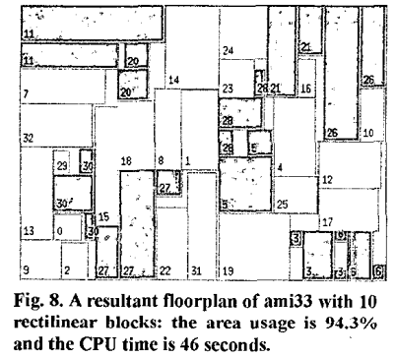
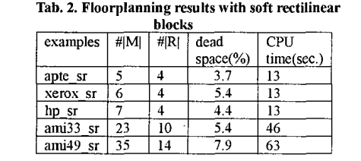
Experimental Result 2
To test capability to handle soft rectilinear block, the paper expanded several block into soft rectilinear blocks, each of them has four possible shape (L,T,Z,ㄩ) .

Slide 28
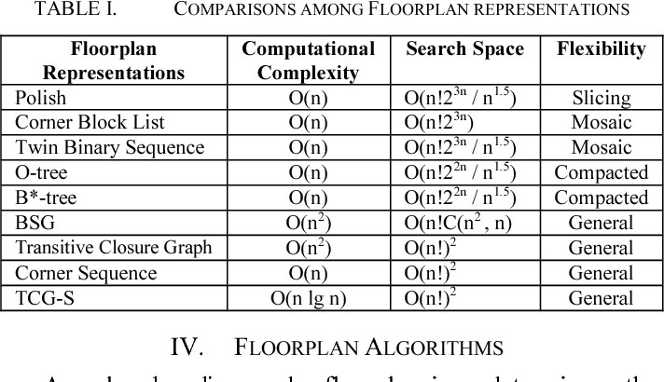
Experimental Result

Slide 29
Conclusion
CBL based algorithm with obstacle-based method and replace-upon-overlap mechanism can efficiency and generality help us to handle floorplanning problem.

Slide 30
The end

